Slide 1
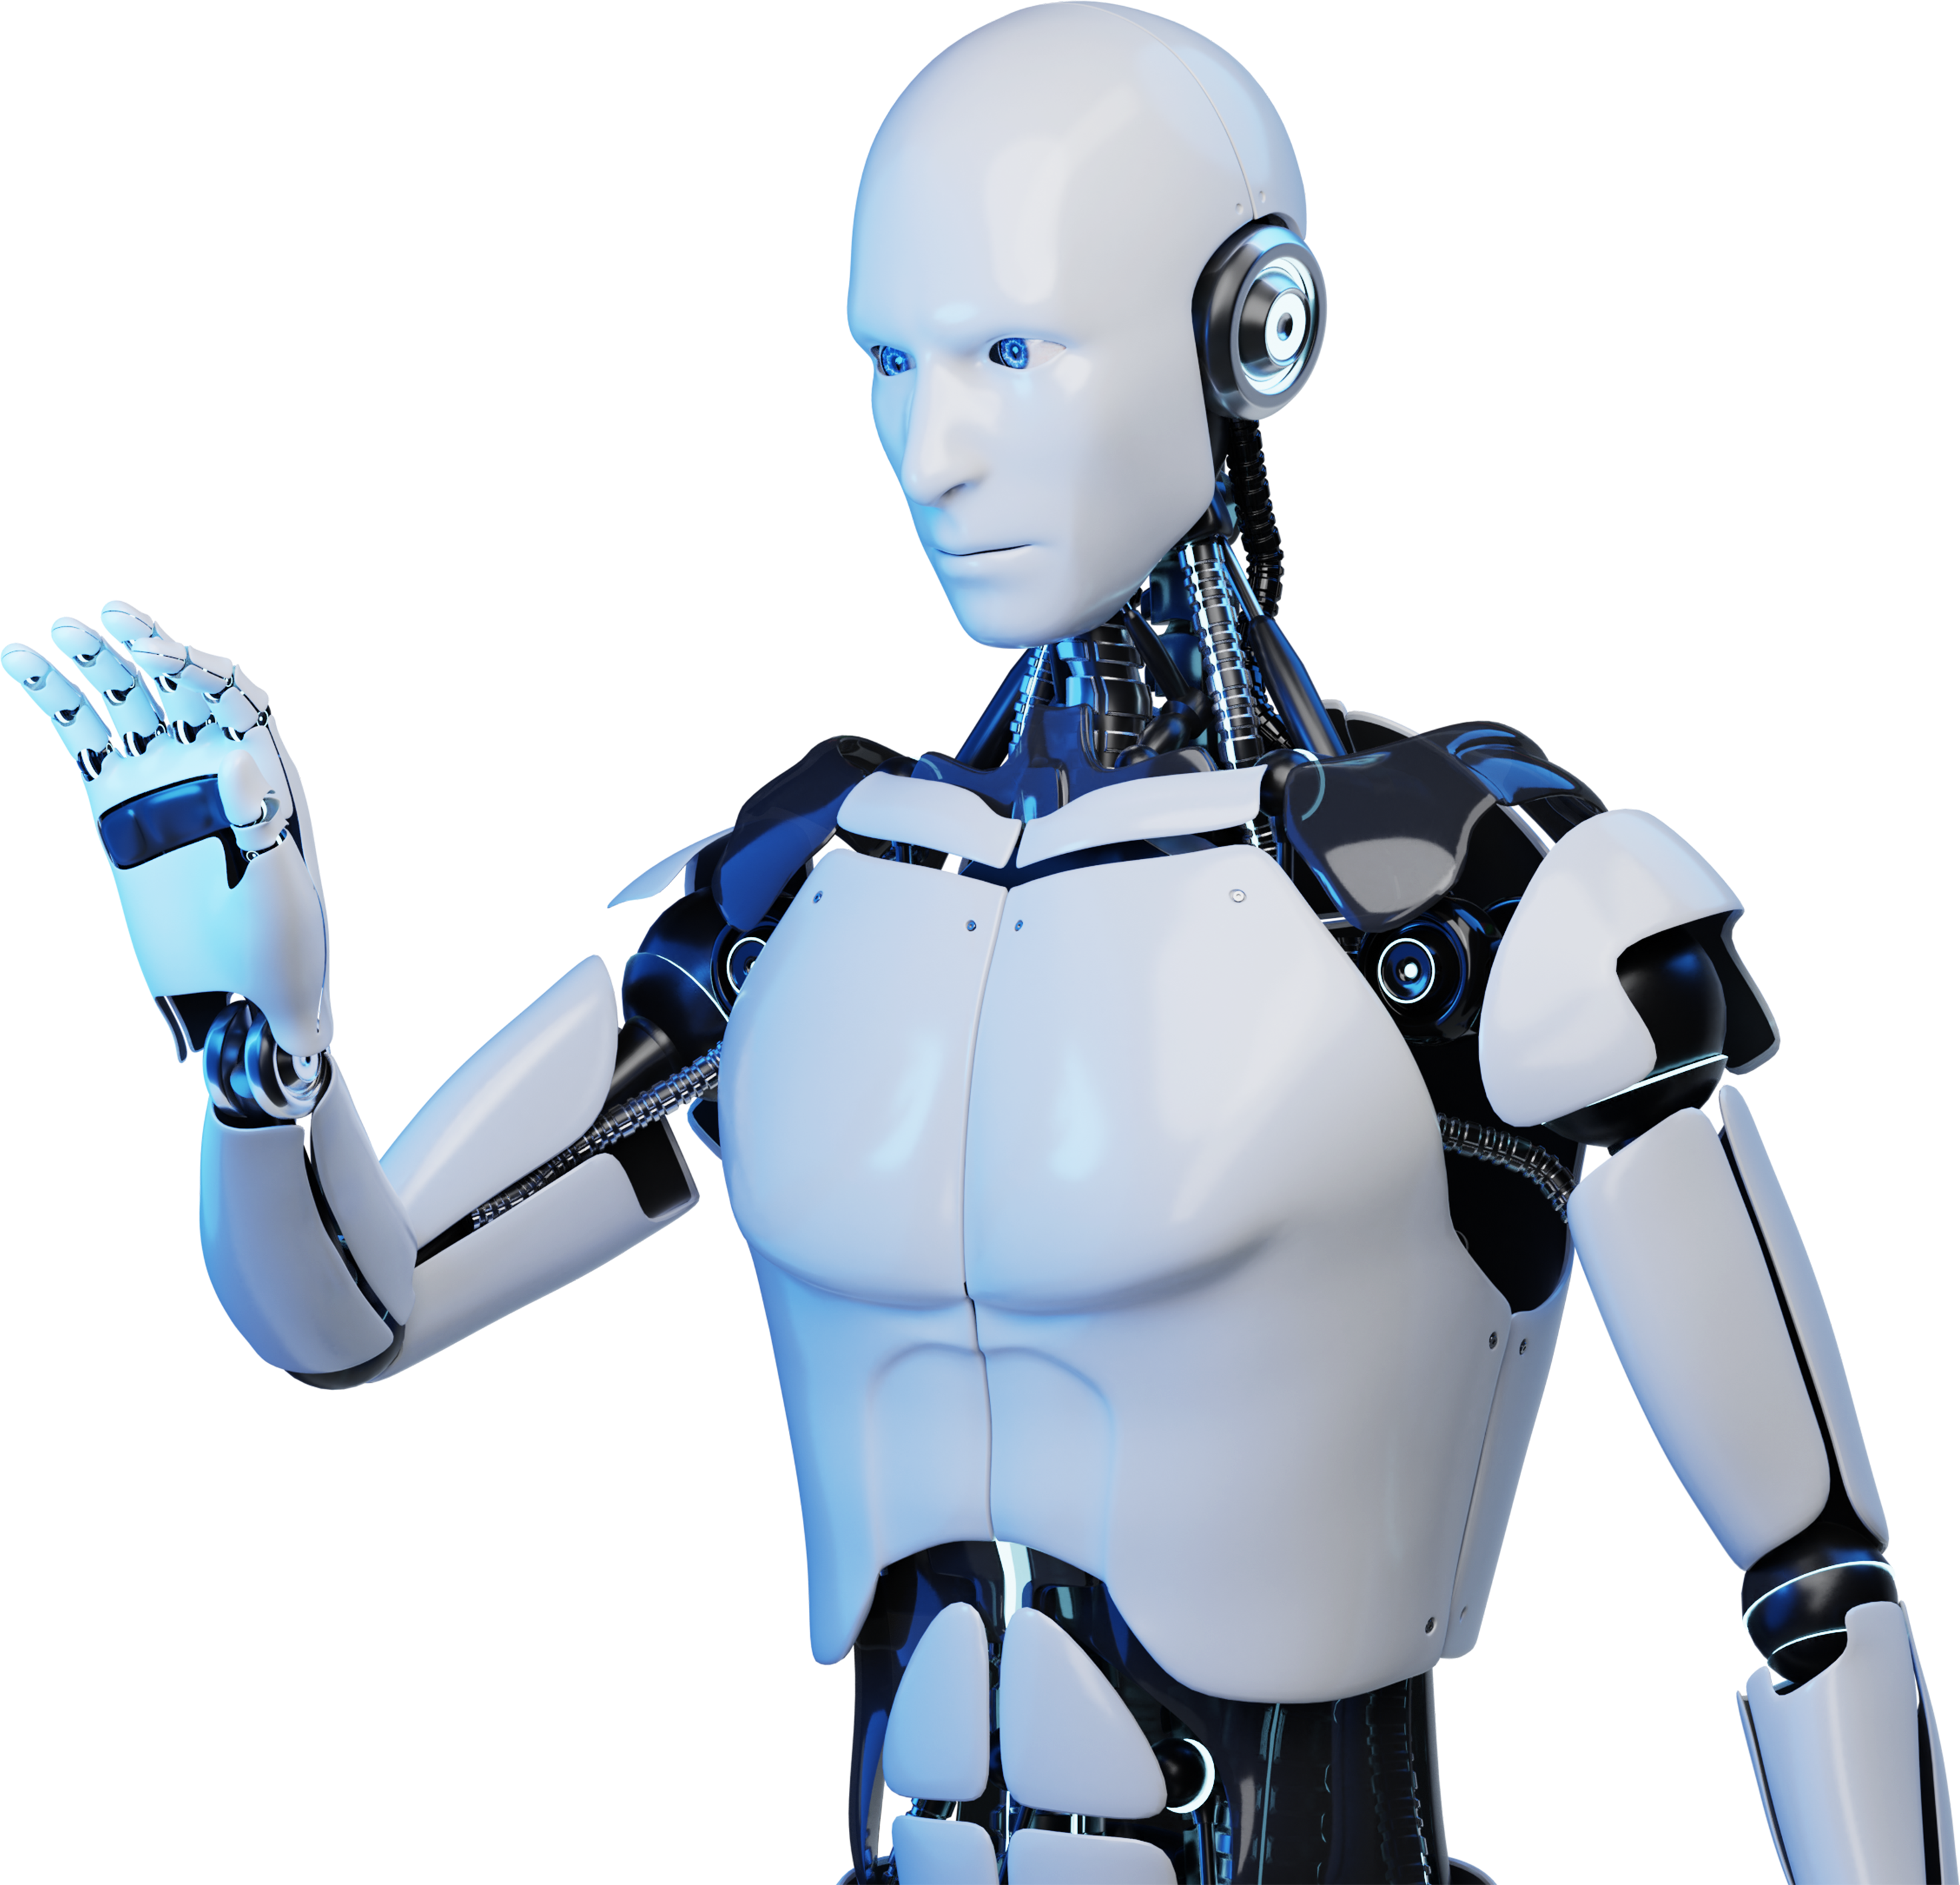
Chatbot
Team Members:
Yogesh
Ganesh
Rajesh
Sharmila devi
Ajeeth

Slide 2
Abstract
Conversational interfaces, or chatbots, provide a novel means of communication between humans and computers. A cutting-edge application called ChartBot was created to simplify the management of educational software companies. In the dynamic market of today, where quality educational resources are highly valued, firms must find innovative approaches to remain competitive. ChartBot combines a wide range of tools to improve job management for organizations.

Slide 3
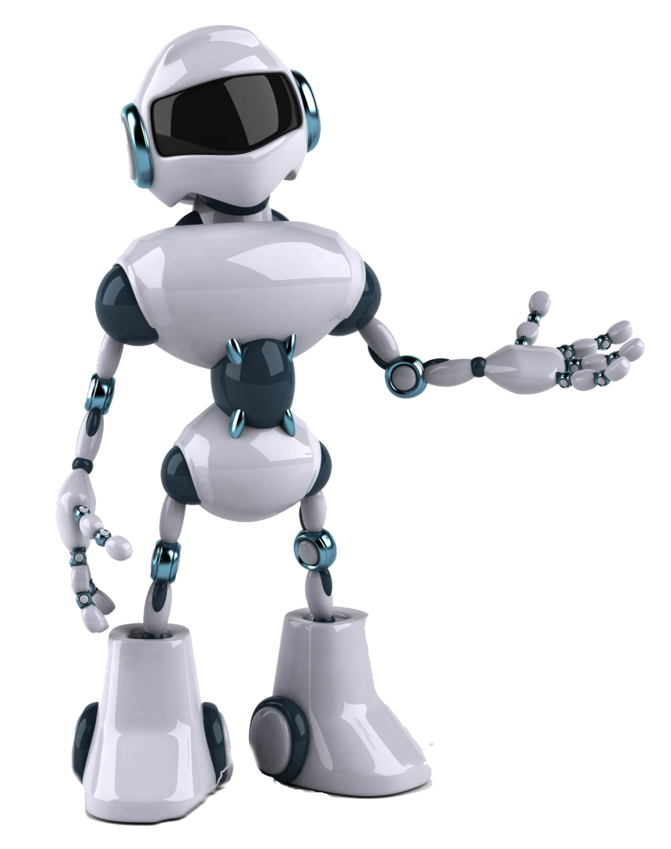
Introduction
Chatbot is a computer program that simulates human conversation, using AI to interact with users and provide assistance.
All kinds of different businesses and organizations are starting to use them because they can
👉 Increase and automate regular support tasks.
👉 Engage users uniquely and entertainingly.
👉 Help customers to increase online sales.
👉 Provide education and information in a friendly and easily understandable style.

Slide 4
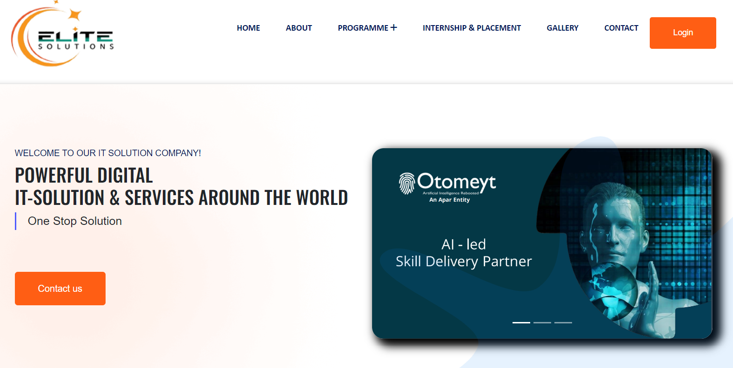

EXISTING
Elite Solutions provides training and services on different technologies and also expertise in engagement and implementation of talent acquisition, and talent development to create a future-ready workforce for the industry.
Elite Solutions has one website it is elitesolutions.org.

Slide 5
Drawbacks
Elite Solutions doesn’t have 24/7 customer service.
Elite completely depends on traditional systems like Gmail or phone.
Takes a lot of time to find the things on the website
Limited support during non-business hours

Slide 6

Proposed System:
To overcome the drawbacks of an elite solutions website we want to create a chatbot.
This chatbot will function as a creative way to offer help and individualized support. By using a chatbot, we can reduce our dependence on traditional support methods like phone calls and emails and provide clients with and practical means of interacting with elite services. To further enhance customer happiness and experience, the chatbot will be built to provide help and information in an accessible and user-friendly way.

Slide 7
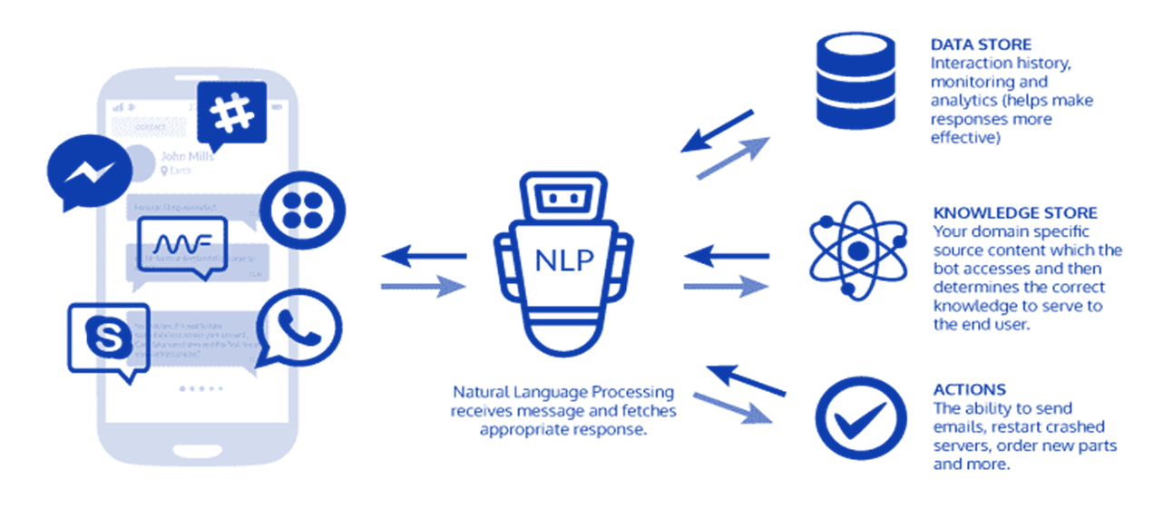
Architecture of Chatbot

Slide 8
ADVANTAGES
Users get immediate responses to their queries, leading to higher customer satisfaction.
We can able to find the type of questions asked by the users.
Chatbots can handle a large volume of inquiries simultaneously, reducing the need for human agents and cutting operational costs.
Chatbot provides 24/7 customer assistance.

Slide 9
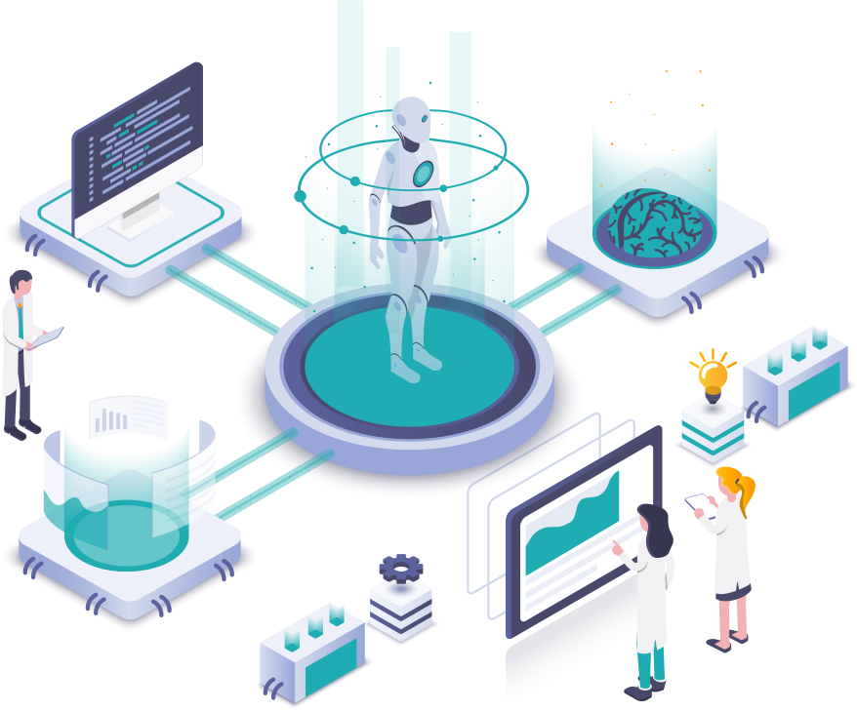
TECHNOLOGIES USED:
React js: React is used to design the interaction page of the chatbot.
Machine Learning: ML algorithms are utilized for training chatbots to recognize patterns in user queries and provide appropriate responses.
NLP: Natural Language Processing (NLP) enables Chatbots to understand and process human language, allowing for more effective communication.
WebSocket or REST API: For real-time communication between the frontend and backend, developers can use WebSocket for bidirectional communication or REST API endpoints for making HTTP requests.

Slide 10
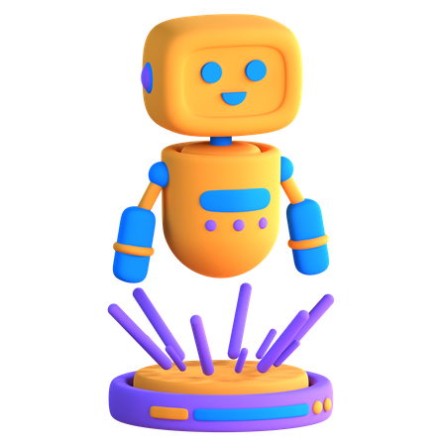
Conclusion
In conclusion, Chatbots revolutionize customer service, enhance user experiences, and drive operational efficiency, empowering businesses to thrive.

Slide 11
Thank You!

